Slide 1
Solving simple linear equations with an additive step
Task A: Additive steps using representations
1) Find the value of the unknown in each bar model. Explain how you know.
a)
15
c)
c
a
9
27
31
This represents the equation:
15 − 9 = a
6 = a solution when a is 6
This represents the equation:
c = 27 + 31
c = 58 solution when c is 58
b)
b
33
d)
8.4
41
d
5.7
This represents the equation:
b = 41 − 33
b = 8 solution when b is 8
This represents the equation:
8.4 − 5.7 = d
2.7 = d solution when d is 2.7
2) Complete the balance scales to show the additive step needed to find the solution. What is the solution for each equation?
a)
b)
c)
19
8
x
2
7
x
11
30
x
−8
−2
−2
−11
−11
19
8
−8
x
2
7
x
11
30
x
5
19
11
x
x
x
solution when x is 5
solution when x is 19
solution when x is 11

Slide 2
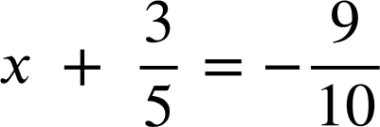
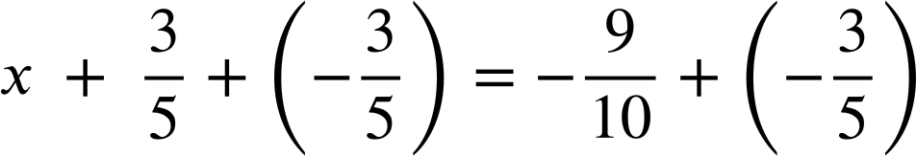



Solving simple linear equations with an additive step
Task B: Writing solutions algebraically
Solve the following equations.
a)
d)
x + 1 | = | 12
x + 1 + (−1) | = | 12 + (−1)
x | = | 11
x + 13 | = | 11
x + 13 + (−13) | = | 11 + (−13)
x | = | −2
b)
e)
x + 3.6 | = | 17.8
x + 3.6 + (−3.6) | = | 17.8 + (−3.6)
x | = | 14.2
x − 10 | = | −8.4
x − 10 + 10 | = | −8.4 + 10
x | = | 1.6
c)
f)
x − 18 | = | 42
x − 18 + 18 | = | 42 + 18
x | = | 60
2) Spot the mistakes in the following methods to solve these equations.
a)
c)
x + 7 | = | −3
x + 7 + (7) | = | −3 + (7)
x | = | 4
x − 5 | = | 10
x − 5 + 10 | = | 10 + 10
x + 5 | = | 20
Should have added −7 not 7 x = −10
Hasn’t isolated x, could now add −5 to both sides x = 15
b)
d)
x + 7.1 | = | 23.5
x + 7.1 + (−7.1) | = | 23.5
x | = | 23.5
x − 23 | = | 23
x − 23 + 23 | = | 23 − 23
x | = | 0
Forgot to add −7.1 to RHS x = 16.4
Subtracted 23 instead of added 23 to RHS x = 46
Mathematics in Education and Industry
v2.3

